Slide 1

Procesamiento de Imágenes
Domingo Mery
Departamento de Ciencia de la Computación
Escuela de Ingeniería
Universidad Católica de Chile
Espacios de Color
[ Capítulo 2 ]

Slide 2
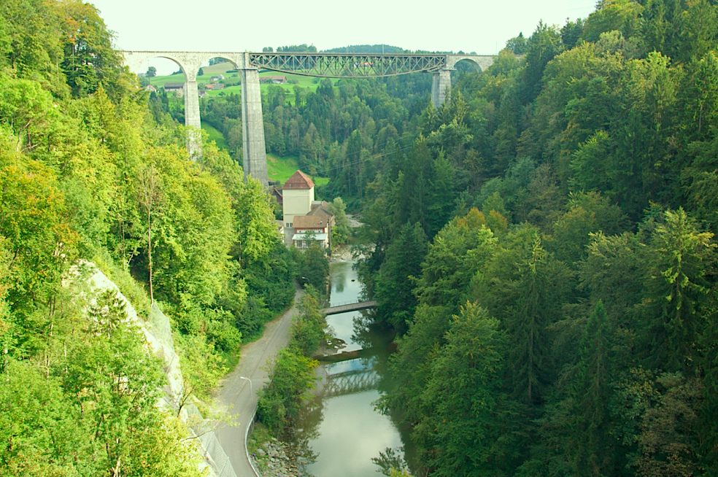

Slide 3
Notes:
Color is extremely subjective and personal. To try to attribute numbers to the brains reaction to visual stimuli is very difficult. The aim of color spaces is to aid the process of describing color, either between people or between machines or programs. http://biology.duke.edu/johnsenlab/pdfs/tech/colorconversion.pdf

Slide 4
El objetivo de los espacios de color es ayudar al proceso de la descripción del color, ya sea entre personas o entre computadores.
Notes:
Color is extremely subjective and personal. To try to attribute numbers to the brains reaction to visual stimuli is very difficult. The aim of color spaces is to aid the process of describing color, either between people or between machines or programs. http://biology.duke.edu/johnsenlab/pdfs/tech/colorconversion.pdf

Slide 5
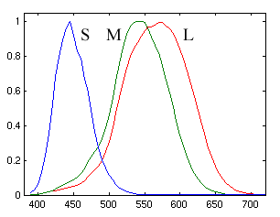
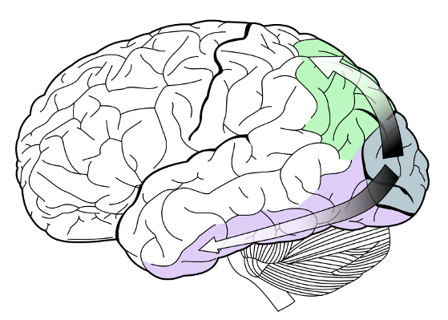
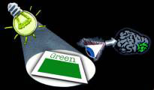
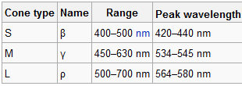
[ Percepción del Color ]
Notes:
Color is the brains reaction to a specific visual stimulus. Although we can precisely describe color by measuring its spectral power distribution (the intensity of the visible electro-magnetic radiation at many discrete wavelengths) this leads to a large degree of redundancy. The reason for this redundancy is that the eye’s retina samples color using only three broad bands, roughly corresponding to red, green and blue light. The signals from these color sensitive cells (cones), together with those from the rods (sensitive to intensity only), are combined in the brain to give several different “sensations” of the color. http://biology.duke.edu/johnsenlab/pdfs/tech/colorconversion.pdf

Slide 6






[ Percepción del Color ]
No olvidar que el color depende del espectro de la fuente
© VectorStock, ID = 19493195

Slide 7
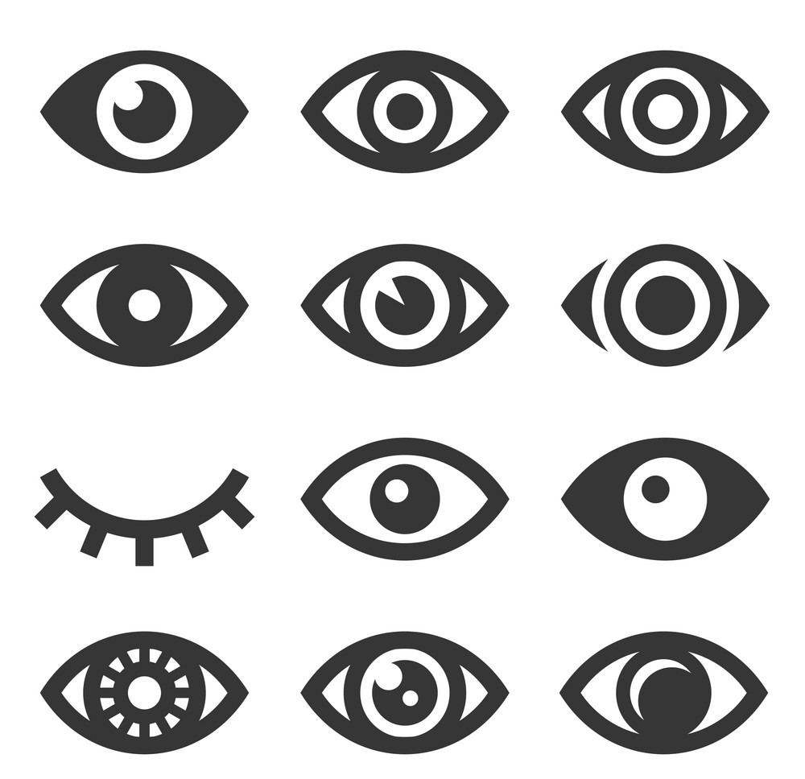
[ Percepción del Color ]
Y depende también de los ojos que miran
© VectorStock, ID = 17886903

Slide 8
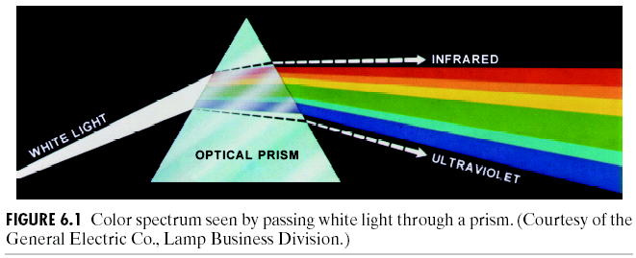
[ Prisma Óptico ]

Slide 9
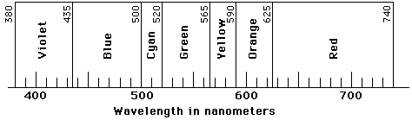
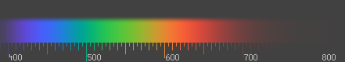
[ Definición del Color ]
El color es el resultado de la percepción de la luz en espectro visible, con longitudes de onda entre 400 nm y 700 nm, que inciden en la retina del ojo.
Longitud de onda [nm]

Slide 10
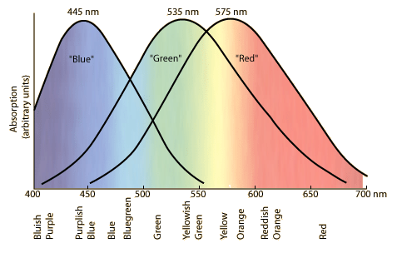
[ Respuesta del ojo humano ]
Notes:
The tri-chromatic theory describes the way three separate lights, red, green and blue, can match any visible colour – based on the eye’s use of three colour sensitive sensors. This is the basis on which photography and printing operate, using three different coloured dyes to reproduce colour in a scene. It is also the way that most computer colour spaces operate, using three parameters to define a colour.

Slide 11
[ Espacios de Color ‘Substractivos’ ]

Slide 12

[ Modelo Substractivo ]
El color que muestra una superficie depende de las partes del espectro visible que no son absorbidas y por lo tanto permanecen visibles.
XXXXXX XXXXXXXXX
Luz Blanca
(todos los colores)

Slide 13
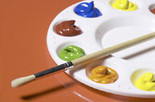
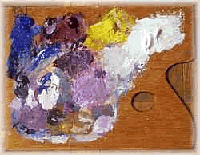
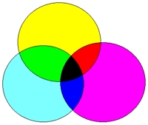
[ Modelo Substractivo ]
Los objetos restan porciones del espectro en determinadas longitudes de onda de la luz, conformando así el color

Slide 14
[ Espacios de Color ‘Aditivos’ ]

Slide 15
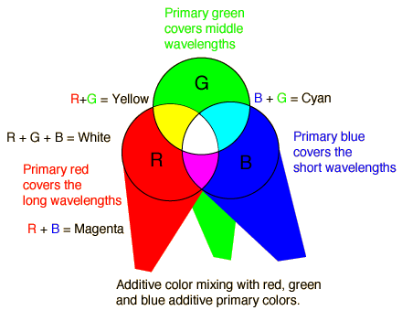
[ Modelo Aditivo ]

Slide 16
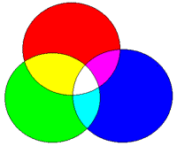
[ Mezcla de Colores ]
ADITIVO
Colores Primarios: RGB
SUBSTRACTIVO
Colores Primarios :CMY, CMYK

Slide 17
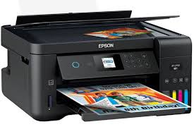

[ Espacio de Color de Impresoras: CMYK ]
To convert RGB to CMYK, use the following equations:
C (Cyan): C = 1 - (R / 255)
M (Magenta): M = 1 - (G / 255)
Y (Yellow): Y = 1 - (B / 255)
K (Black): K = 1 - (Max(C, M, Y))
Calculating CMY:
For each color channel (Red, Green, Blue), subtract its value from 255 (the maximum value) and divide by 255 to get the corresponding CMY value.
Calculating K (Black):
Find the highest value among C, M, and Y, then subtract that value from 1 to get the black component.

Slide 18
[ Espacio de Color RGB ]

Slide 19
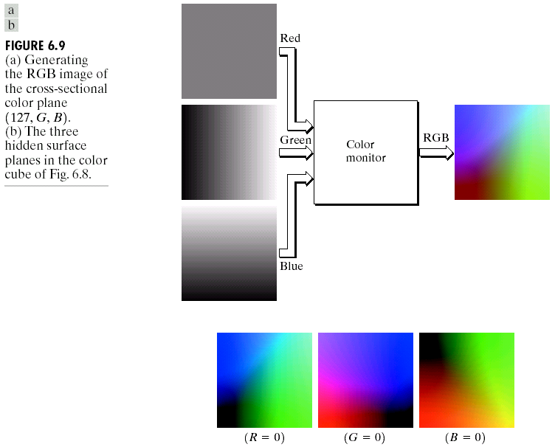
[ Espacio de Color RGB ]
R. Gonzalez, R. Woods, S. Eddins (2009): Digital Image Processing Using MATLAB, 2nd edition. Gatesmark Publishing.

Slide 20
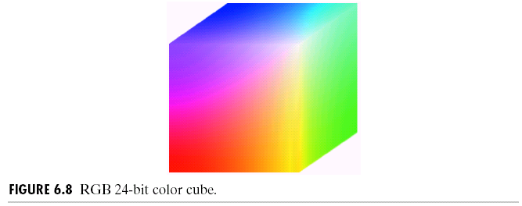
[ Espacio de Color RGB ]

Slide 21
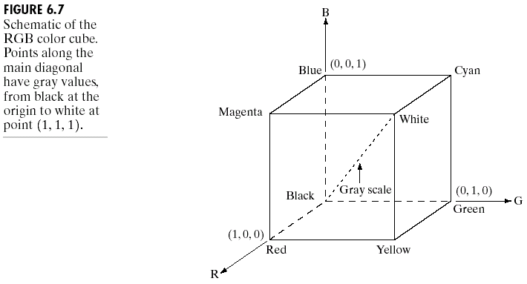
[ Espacio de Color RGB ]
R. Gonzalez, R. Woods, S. Eddins (2009): Digital Image Processing Using MATLAB, 2nd edition. Gatesmark Publishing.

Slide 22
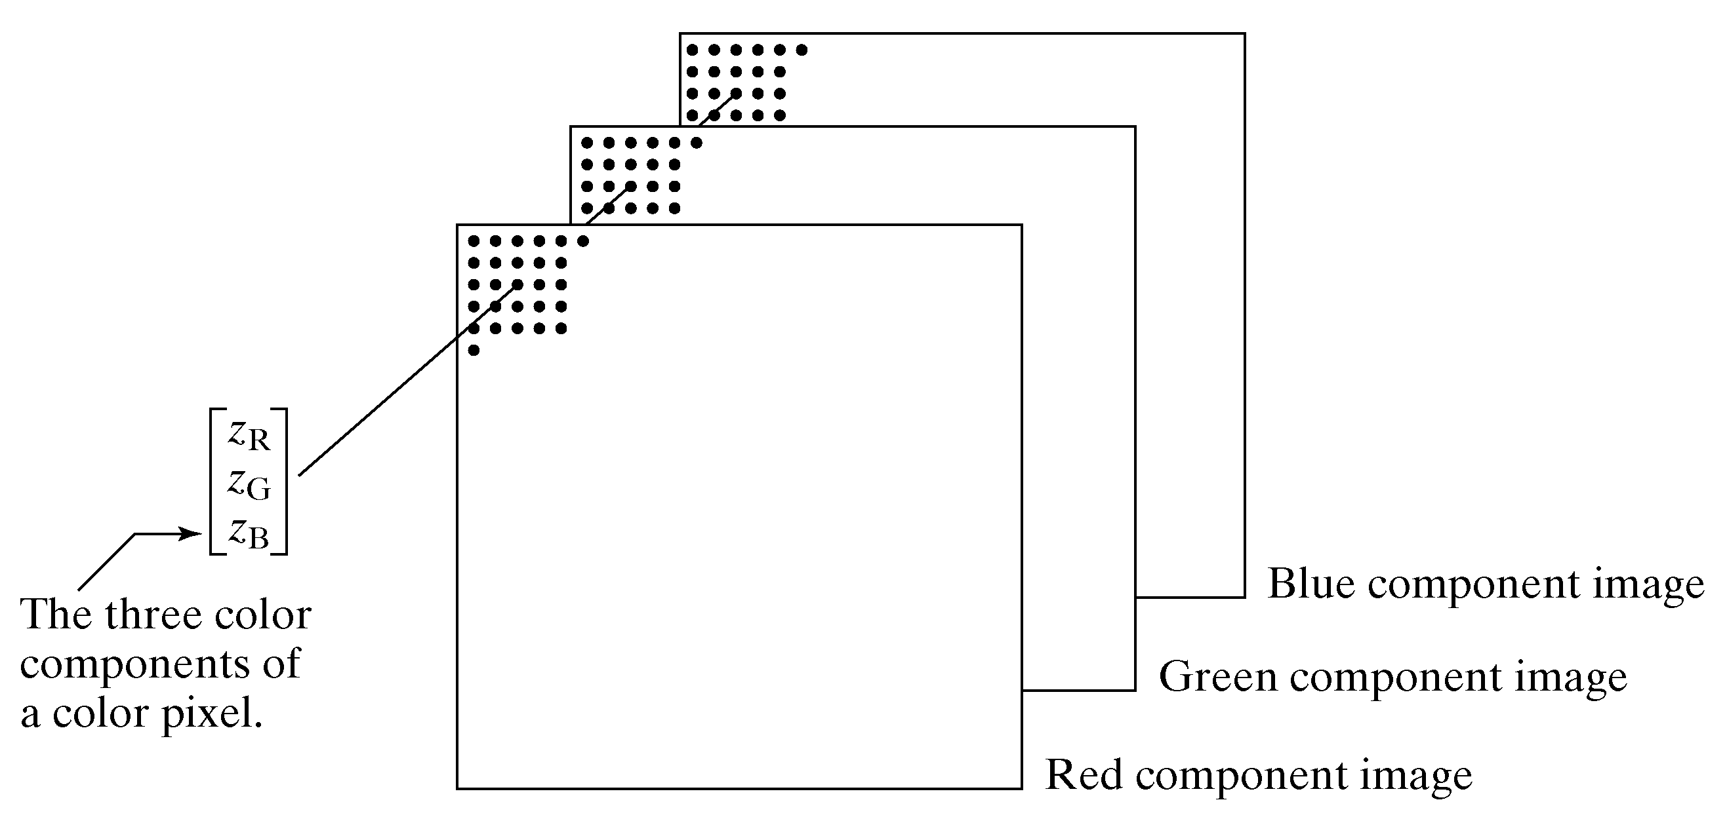
[ Espacio de Color RGB: Cómo se almacena una imagen a color 1/2 ]
Imagen digital a color
B
G
R
La imagen a color de N x M pixeles es almacenada como tres matrices de NxM pixeles, una para cada color (R,G,B). Así, el color del pixel (i,j) queda definido por el color dado por R(i,j), G(i,j) y B(i,j).
R. Gonzalez, R. Woods, S. Eddins (2009): Digital Image Processing Using MATLAB, 2nd edition. Gatesmark Publishing.

Slide 23
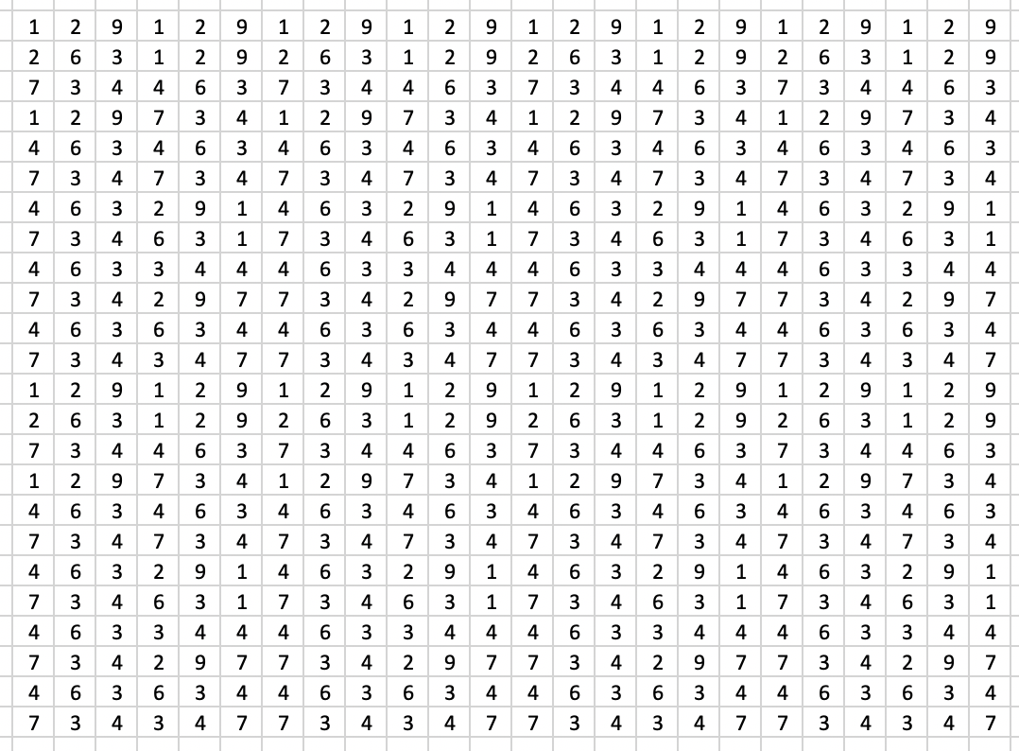
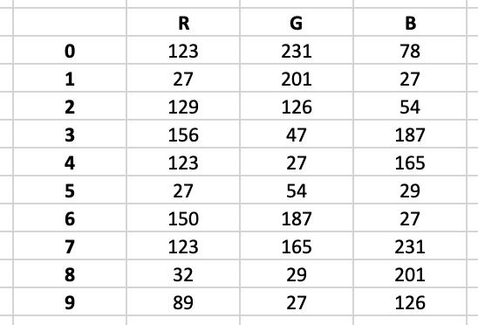
[ Espacio de Color RGB: Cómo se almacena una imagen a color 2/2 ]
Imagen (X)
Paleta
La imagen a color de N x M pixeles es almacenada como una matriz X de NxM pixeles que almacena índices de 0 a n-1, y una paleta de colores almacenada como una matriz de n x 3 elementos. Así, el color del pixel (i,j) de la imagen está definido en la fila k de la paleta, donde k = X(i,j).

Slide 24
[ Espacio de Color HSV ]

Slide 25

[ Espacio de Color HSV ]

Slide 26
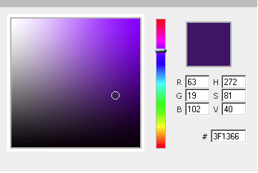
[ Espacio de Color HSV ]
Color Picker Tool:
https://url-decode.com/tool/hsv-to-rgb
H
V
S

Slide 27
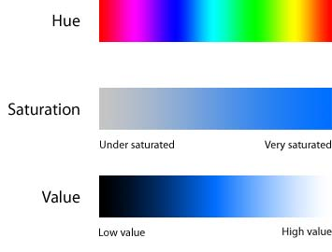
[ Espacio de Color HSV ]

Slide 28
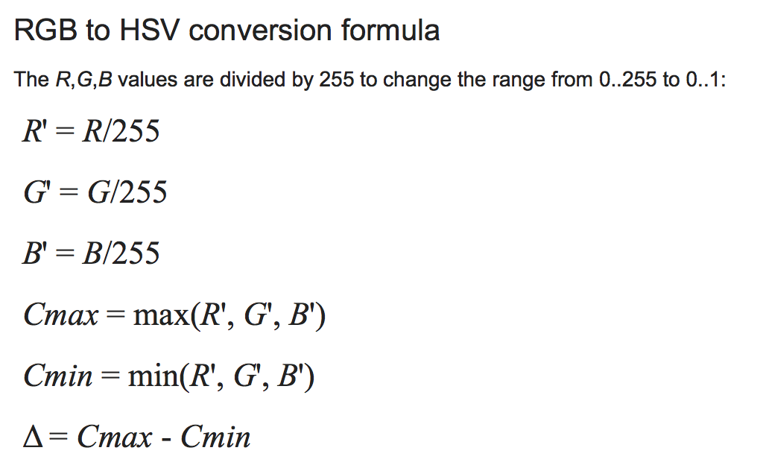
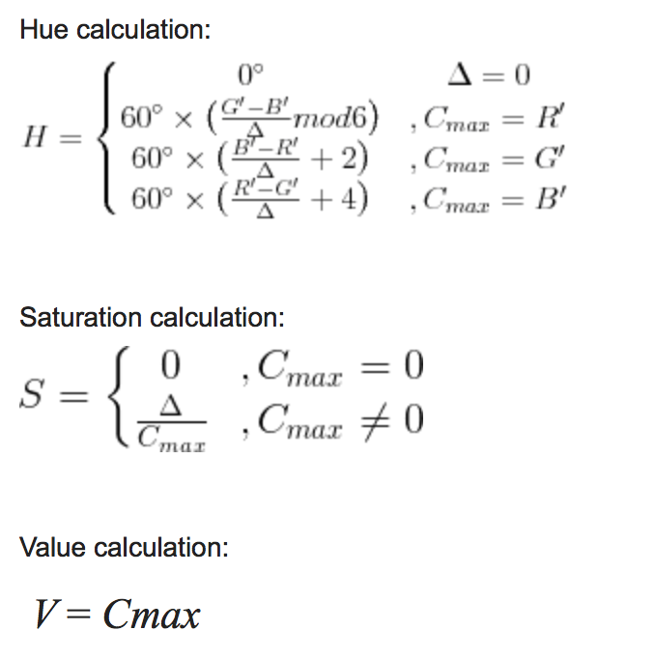
[ Espacio de Color HSV ]
Conversión RGB a HSV

Slide 29
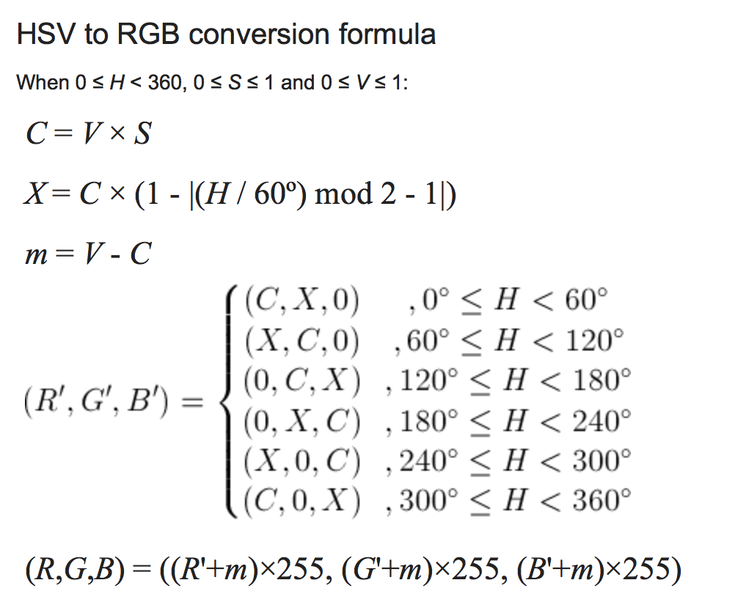
[ Espacio de Color HSV ]
Conversión HSV a RGB

Slide 30
[ Lightroom Demo ]

Slide 31
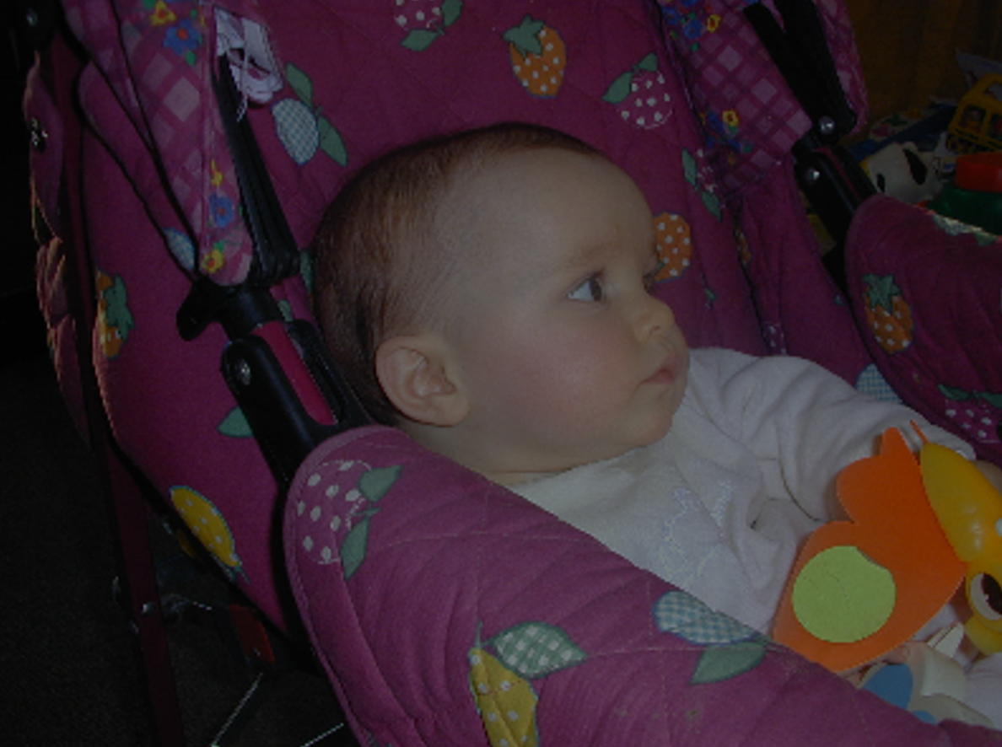
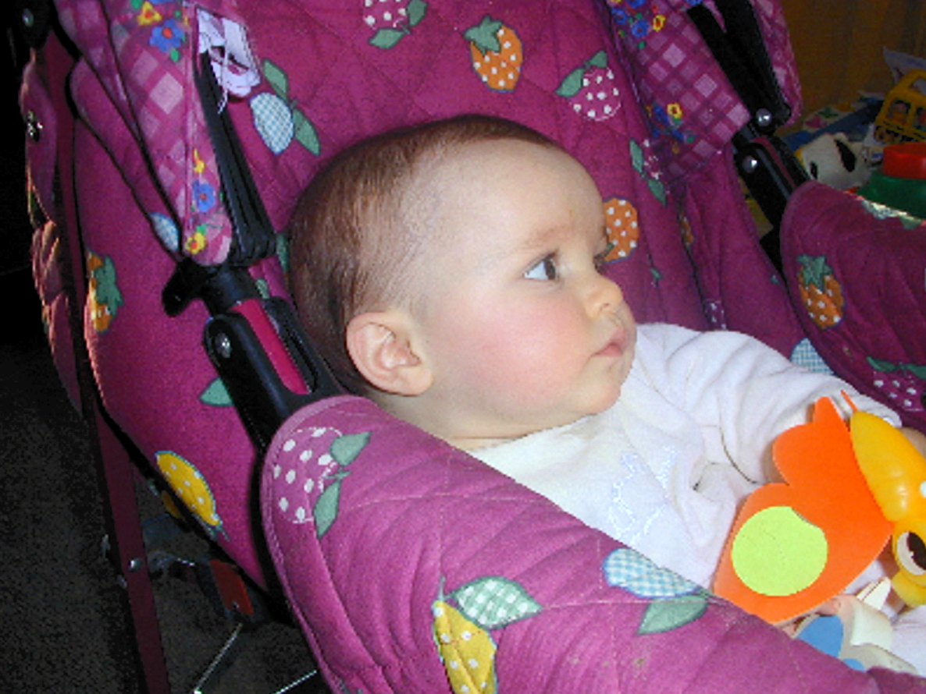
[ Cómo mejorar una imagen a color ]

Slide 32
[ Cómo mejororar una imagen a color ]
Tomar la imagen a color
Convertir RGB a HSV
Ecualizar sólo el canal V
Convertir el nuevo HSV a RGB
Fin

Slide 33
[ Colab Demo ]

Slide 34
[ Espacio de Color XYZ ]

Slide 35
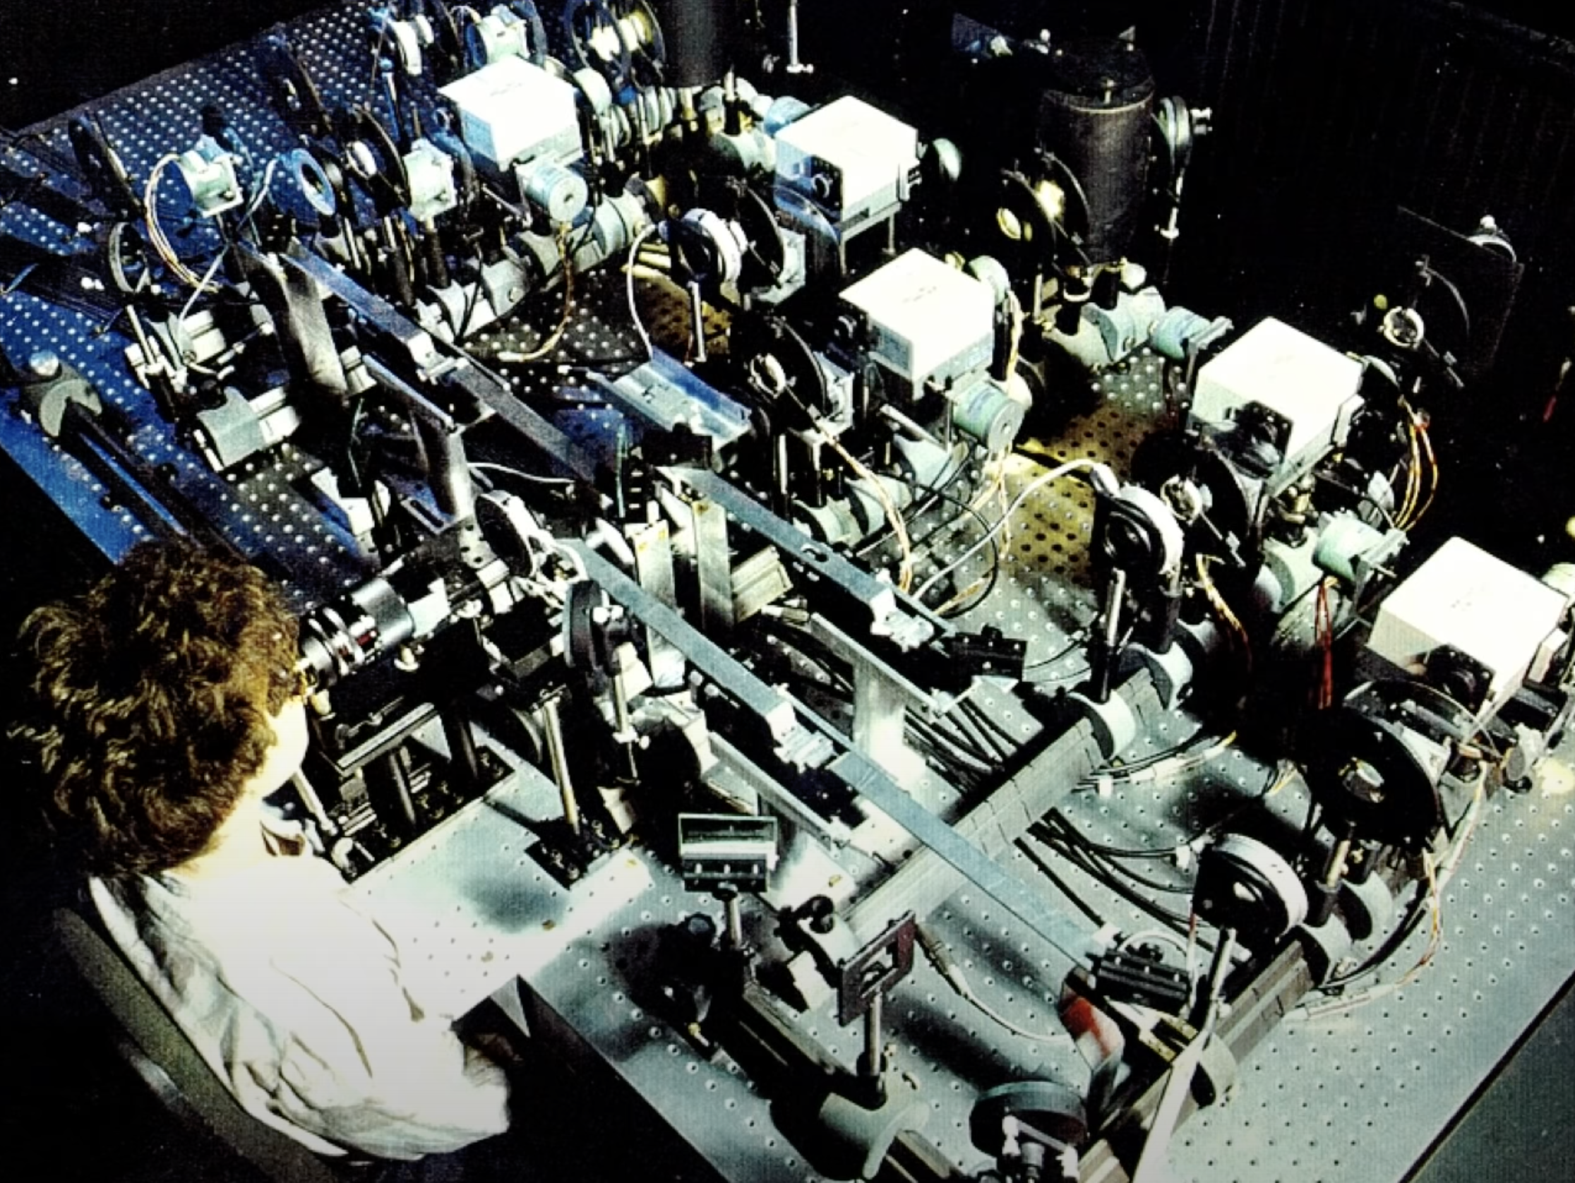
Experimento Wright – Guild
(alrededor de 1920)

Slide 36
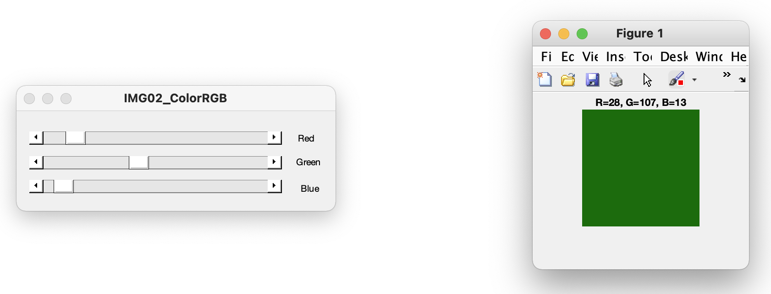

Pesos
Colores
Primarios
+
Resultado
0 255
-
Error
Referencia
Notes:
Proyectar, y pasarse a Matlab y corer programa IMG02_ColorRGB

Slide 37
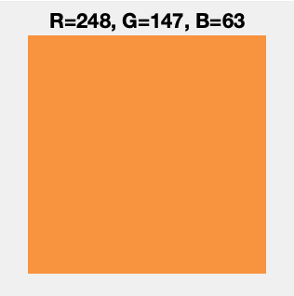
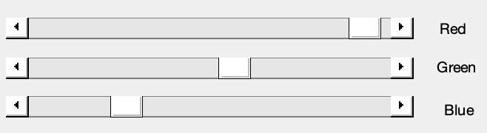
Pesos
Colores
Primarios
+
Resultado
0 255
-
OK
Referencia

Slide 38
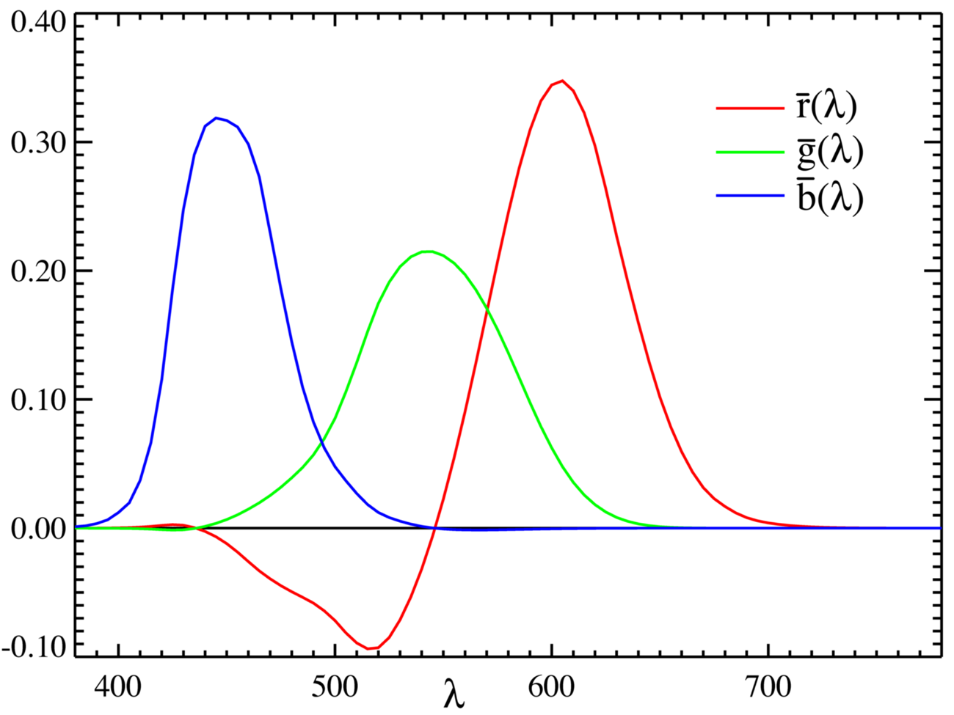
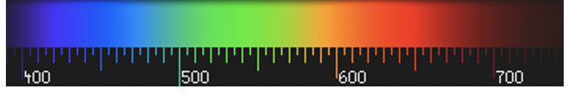
Notes:
Los valores negativos se logran sumando rojo a la referencia

Slide 39
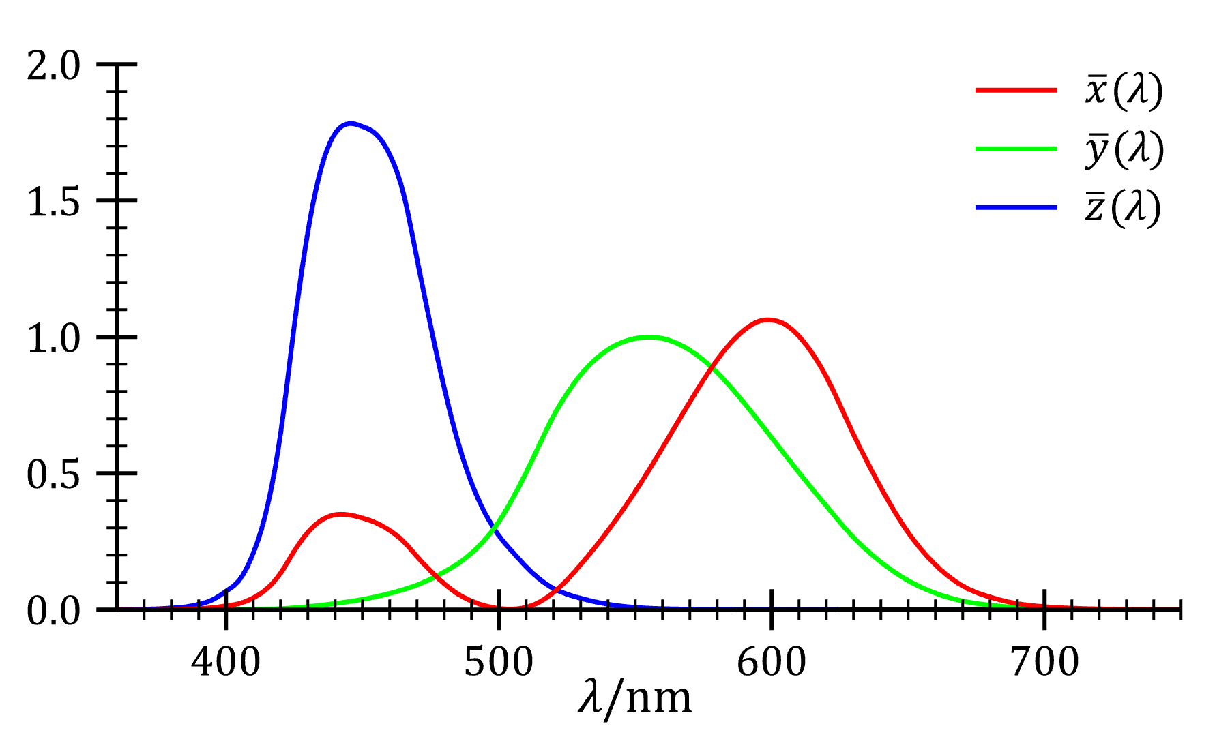
Notes:
Los primaries son imaginarios, pero las matching functions son siempre positivas….
De Wikipedia: https://en.wikipedia.org/wiki/CIE_1931_color_space
Meaning of X, Y and Z[edit]
This section does not cite any sources. Please help improve this section by adding citations to reliable sources. Unsourced material may be challenged and removed. (August 2015) (Learn how and when to remove this template message)
A comparison between a typical normalized M cone's spectral sensitivity and the CIE 1931 luminosity function for a standard observer in photopic vision.
When judging the relative luminance (brightness) of different colors in well-lit situations, humans tend to perceive light within the green parts of the spectrum as brighter than red or blue light of equal power. The luminosity function that describes the perceived brightnesses of different wavelengths is thus roughly analogous to the spectral sensitivity of M cones.
The CIE model capitalizes on this fact by setting Y as luminance. Z is quasi-equal to blue, or the S cone response, and X is a mix of response curves chosen to be nonnegative. The XYZ tristimulus values are thus analogous to, but different from, the LMS cone responses of the human eye. Setting Y as luminance has the useful result that for any given Y value, the XZ plane will contain all possible chromaticities at that luminance.
The unit of the tristimulus values X, Y, and Z is often arbitrarily chosen so that Y = 1 or Y = 100 is the brightest white that a color display supports. In this case, the Y value is known as the relative luminance. The corresponding whitepoint values for X and Z can then be inferred using the standard illuminants.

Slide 40
Notes:
Los valores negativos se logran sumando rojo a la referencia

Slide 41
Z
Z
Y
Plano
X+Y+Z = 1
X
X
Y

Slide 42
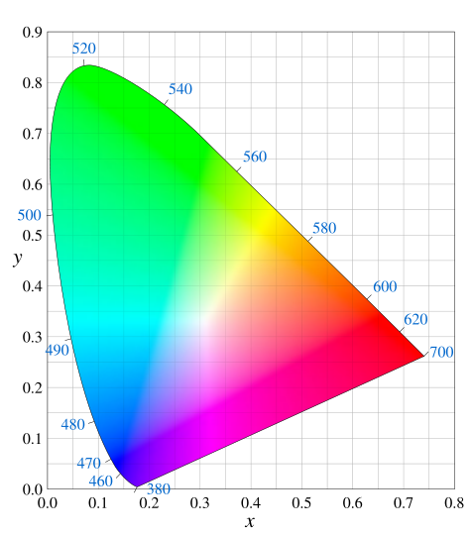
[ Diagrama CIE xy ]

Slide 43
[ Diagrama CIE xy ]
Posibles colores usando mezcla aditiva
Source 1
Source 2

Slide 44
[ Diagrama CIE xy ]
Posibles colores usando mezcla aditiva
Source 1
Source 2
Source 3

Slide 45
[ Diagrama CIE xy ]
Hue

Slide 46
[ Diagrama CIE xy ]
Saturación

Slide 47
[ Espacio de Percepción Uniforme ]

Slide 48
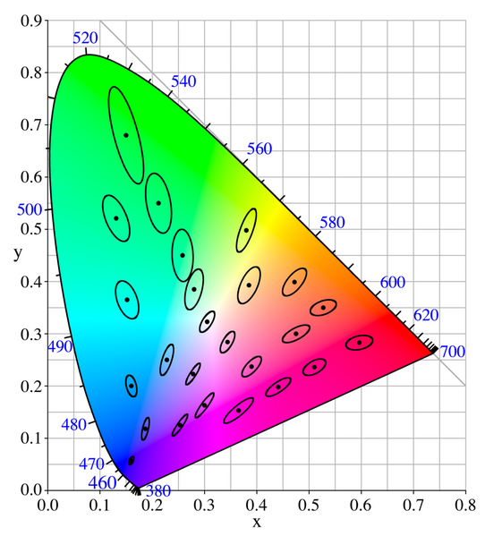
[ Colores Similares: Elipses de MacAdam ]

Slide 49
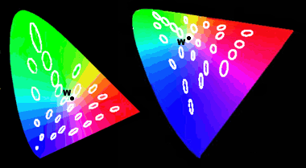
[ Diagrama CIE xy vs. CIE u’v’: Elipses de MacAdam ]

Slide 50
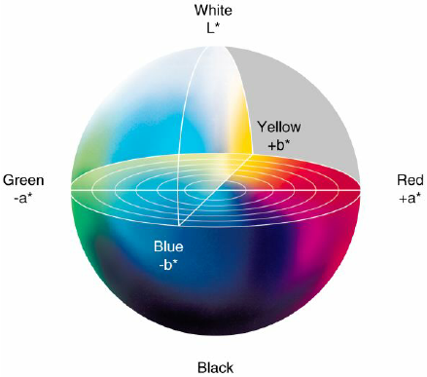
[ Diagrama Lab ]

Slide 51
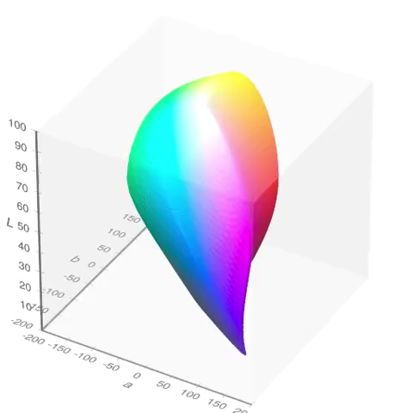
[ Diagrama Lab ]

Slide 52
[ Conversiones ]
http://brucelindbloom.com/

Slide 54

[ Diagram CIE RGB ]

Slide 55
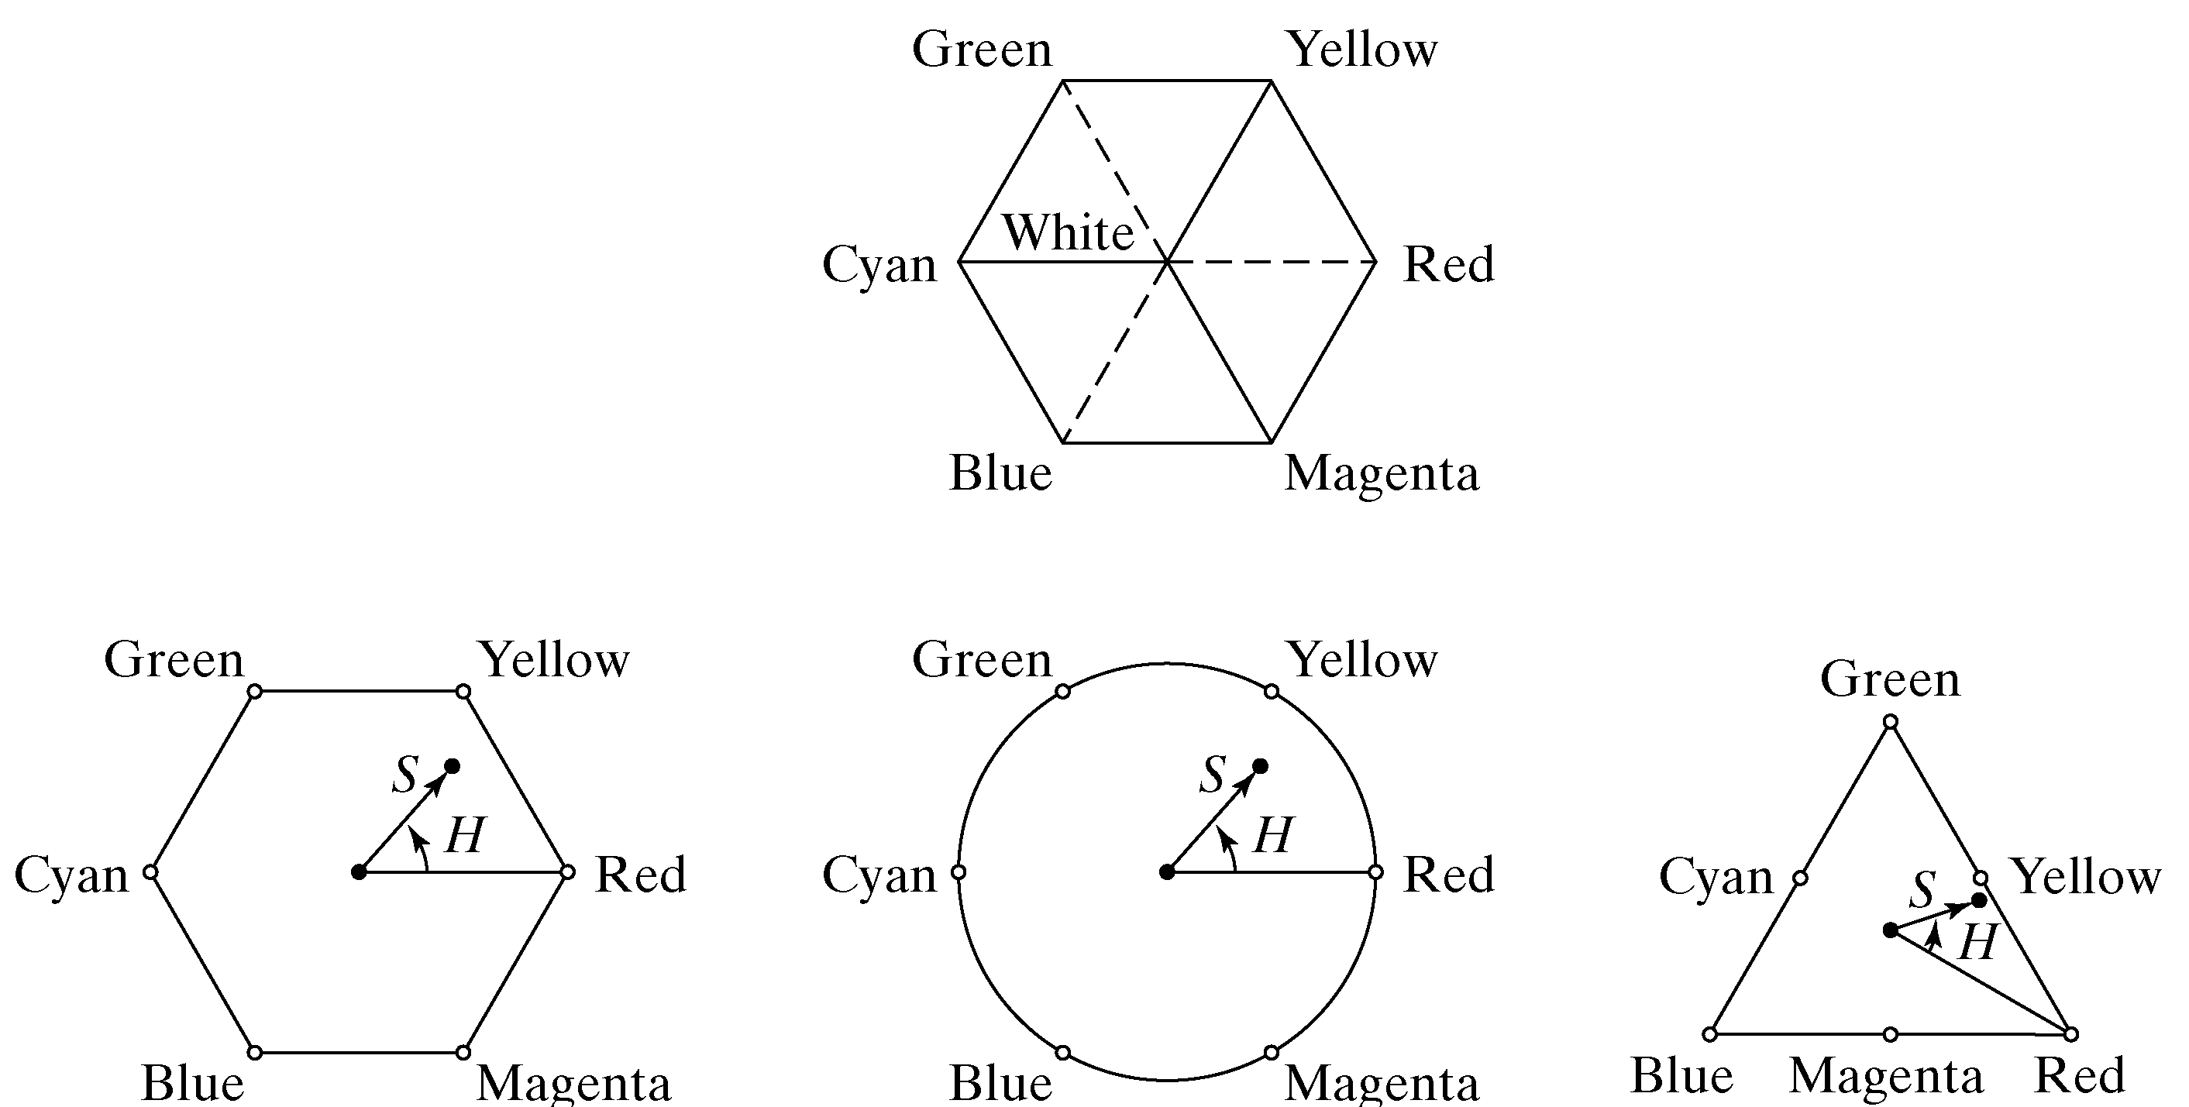
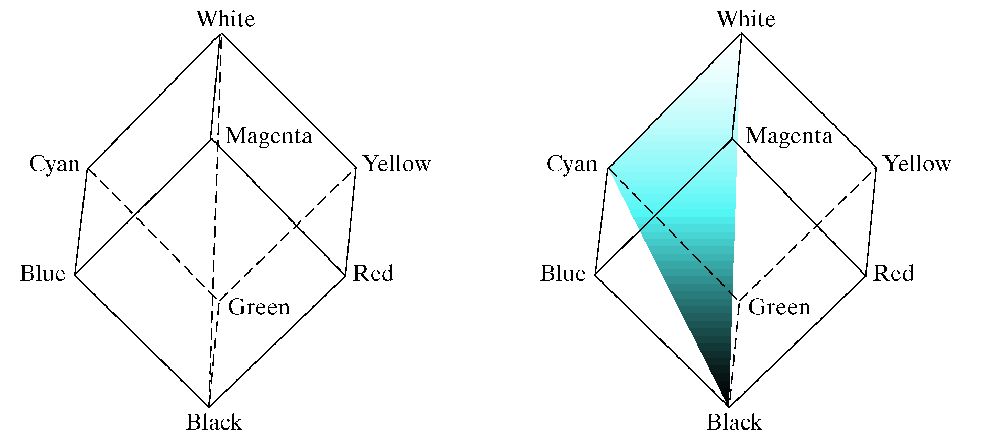
[ Color Space HSI ]

Slide 56
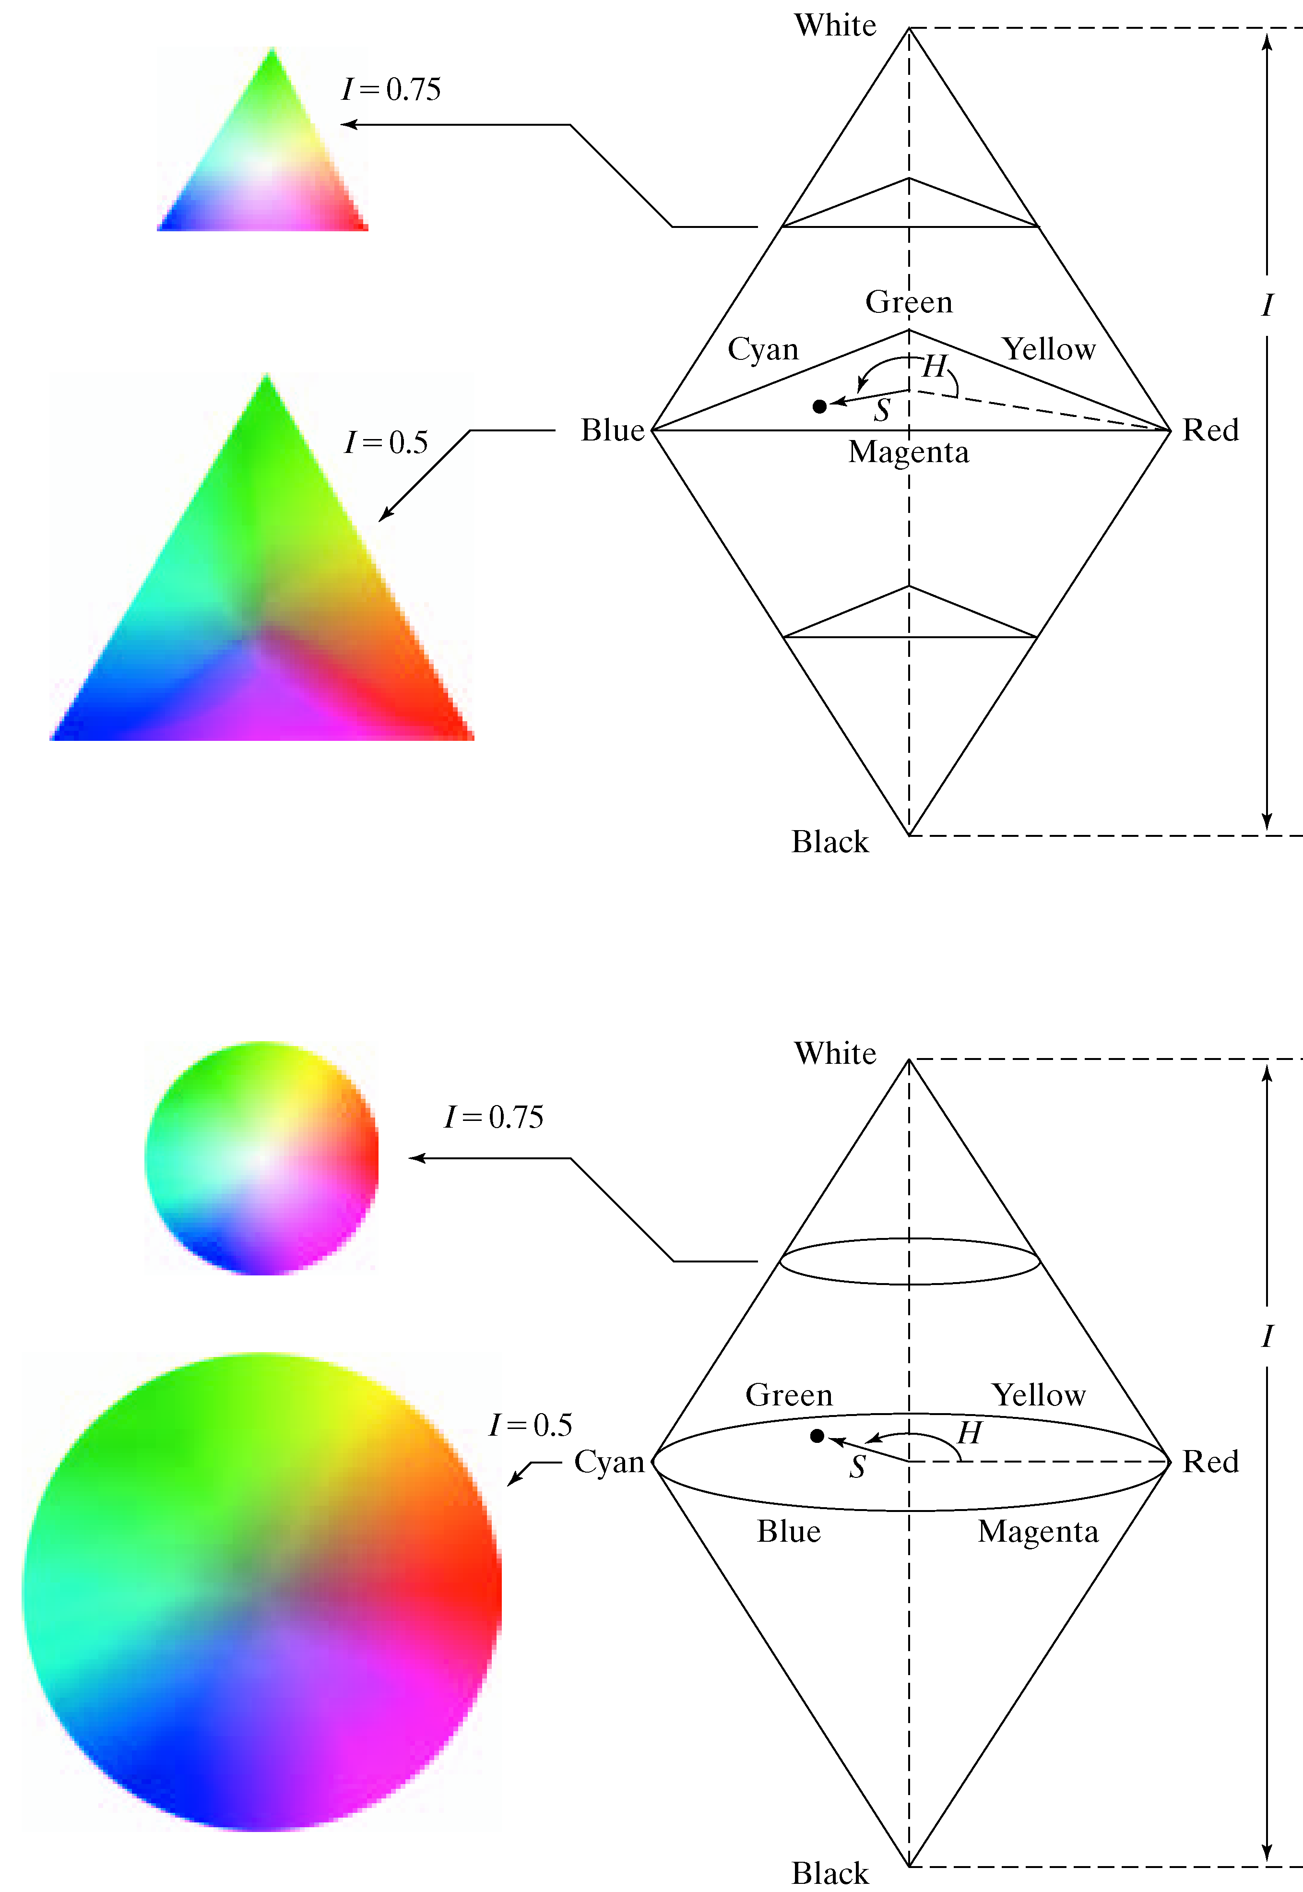
[ Color Space HSI ]

Slide 57
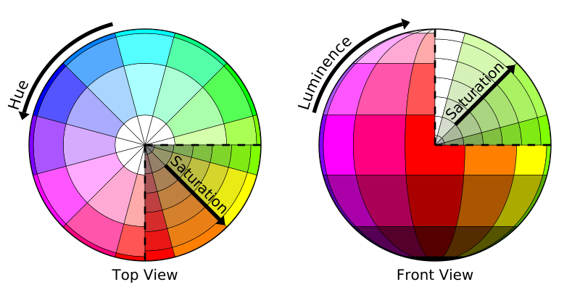
[ Color Space HSL ]

Slide 58
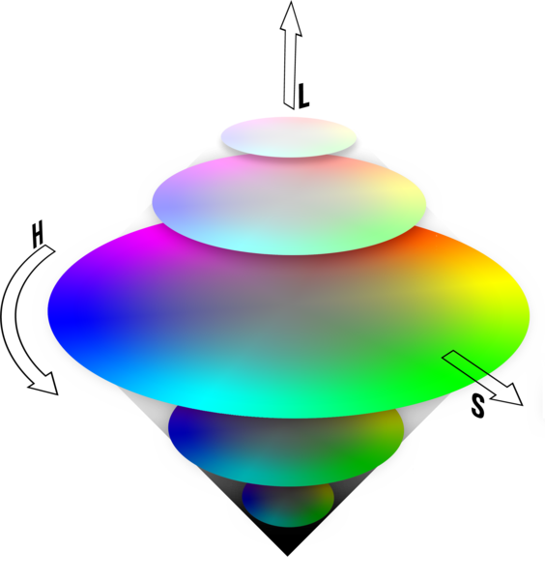
[ Color Space HSL ]

Slide 59
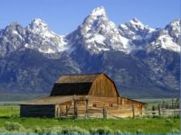
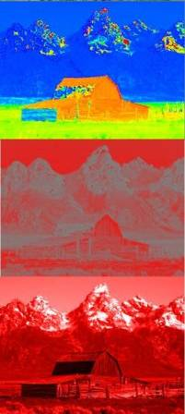
[ Color Space HSL ]
H
S
L

Slide 60
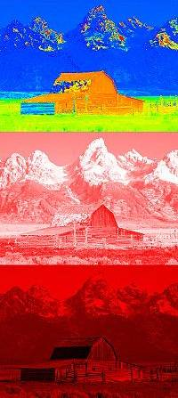
[ Color Space HSV ]
H
S
V

Slide 61
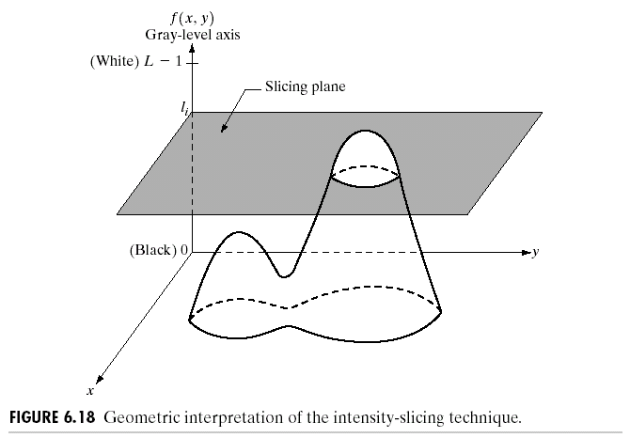

[ Pseudocolor ]
R. Gonzalez, R. Woods, S. Eddins (2009): Digital Image Processing Using MATLAB, 2nd edition. Gatesmark Publishing.

Slide 62

[ Pseudocolor ]
R. Gonzalez, R. Woods, S. Eddins (2009): Digital Image Processing Using MATLAB, 2nd edition. Gatesmark Publishing.

Slide 63

[ Pseudocolor ]
R. Gonzalez, R. Woods, S. Eddins (2009): Digital Image Processing Using MATLAB, 2nd edition. Gatesmark Publishing.

Slide 64

[ Pseudocolor ]
R. Gonzalez, R. Woods, S. Eddins (2009): Digital Image Processing Using MATLAB, 2nd edition. Gatesmark Publishing.

Slide 65

[ Pseudocolor ]
R. Gonzalez, R. Woods, S. Eddins (2009): Digital Image Processing Using MATLAB, 2nd edition. Gatesmark Publishing.

Slide 66

[ Pseudocolor ]
R. Gonzalez, R. Woods, S. Eddins (2009): Digital Image Processing Using MATLAB, 2nd edition. Gatesmark Publishing.

Slide 67

[ Pseudocolor ]
R. Gonzalez, R. Woods, S. Eddins (2009): Digital Image Processing Using MATLAB, 2nd edition. Gatesmark Publishing.

Slide 68

[ Pseudocolor ]
R. Gonzalez, R. Woods, S. Eddins (2009): Digital Image Processing Using MATLAB, 2nd edition. Gatesmark Publishing.

Slide 69



[ Pseudocolor ]
R. Gonzalez, R. Woods, S. Eddins (2009): Digital Image Processing Using MATLAB, 2nd edition. Gatesmark Publishing.

Slide 70

[ Pseudocolor ]

Slide 71

[ Temperature of Color ]

Slide 72


[ Temperature of Color ]

